Slide 1
Mechanistic Modeling of ESP Performance under Various Flow Conditions
Jianjun Zhu
McDougall School of Petroleum Engineering
The University of Tulsa

Slide 2
Applications
Gas entrainment, high-viscosity fluid, oil/water emulsion in oil production affect ESP boosting pressure significantly
Mechanistic model can better predict ESP performance and design ESP-based production system
Experimental data used to validate mechanistic models and develop closure relationships

Slide 3
Objectives
Collect extensive ESP experimental results with many different pumps
Validate mechanistic models for single-phase, gas-liquid, emulsion flows with experimental data
Further development of mechanistic models and closure laws

Slide 4
Outline
TUALP ESP Experimental Database
Mechanistic Model Validation
Model Overview
Single-phase Flow
Emulsion Flow
Gas-liquid Flow
Conclusions and Discussions
Future Work

Slide 5
Experimental Data Bank
TUALP conducted extensive experimental tests of ESP performance under various flow conditions
ESP: GC-6100, TE-2700, DN-1750, P100
High-viscosity fluid flow: TE-2700, DN-1750, P100
Gas/liquid two-phase flow: GC-6100, TE-2700
Oil/water emulsion flow: DN-1750
The new data bank is based on SQLite

Slide 6
Experimental Data Bank…
Data bank includes:
GC-6100 ESP
Gamboa (2008): 21,050 data points
TE-2700 ESP
Zhu (2017): 870 data points
Zhang (2017): 94 data points
DN-1750 ESP
Solano (2009): 168,883 data points
Banjar (2018): 1642 data points
P100 ESP: 390 data points

Slide 7
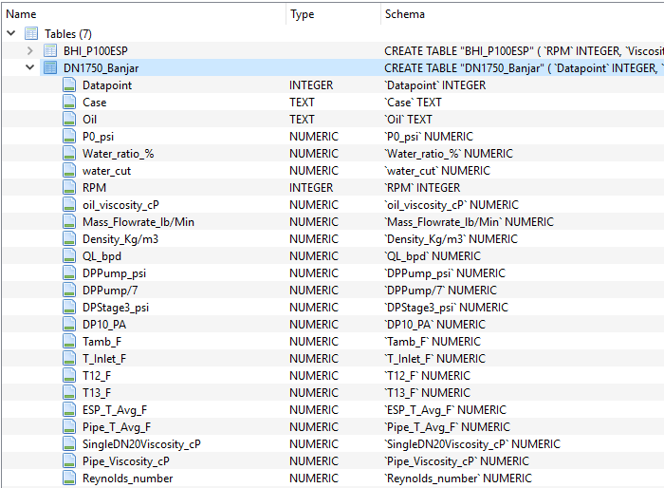
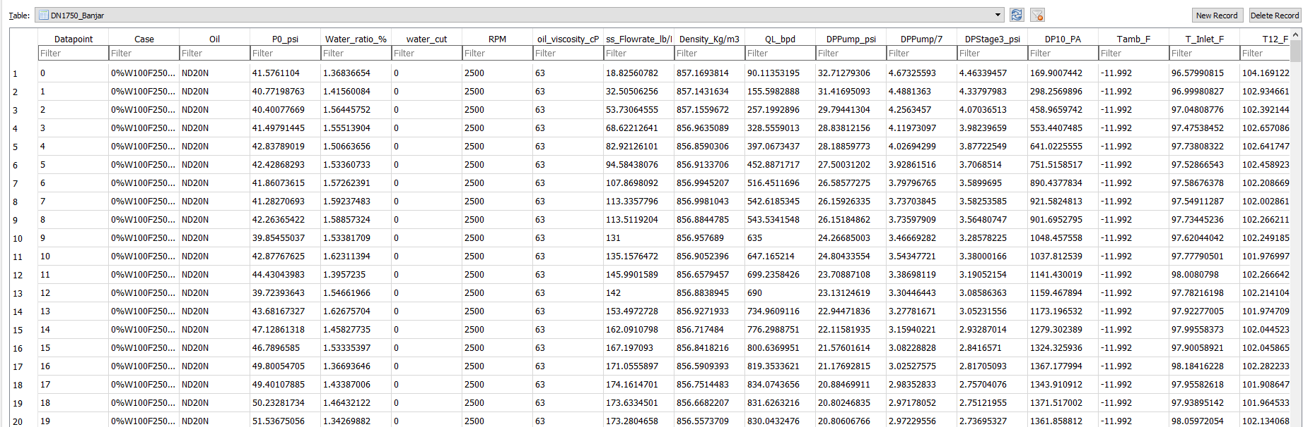
Experimental Data Bank…
Browse the database

Slide 8
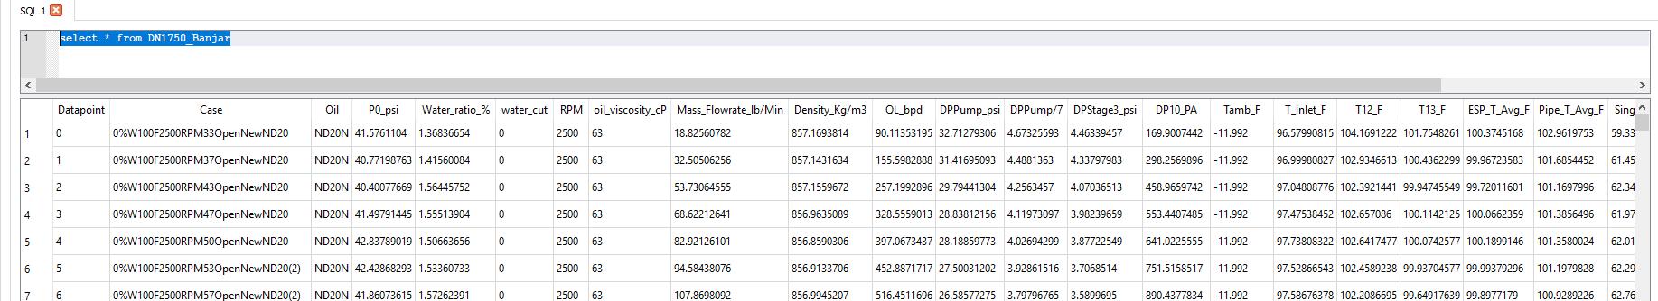
Experimental Data Bank…
Query the database
SQL console:
select * from DN1750_Banjar
Python console:
import sqlite3
conn = sqlite3.connect(“ESP.db”) c = conn.cursor()
c.execute(“select * from DN1750_Banjar”)
conn.commit()
Conn.close()

Slide 9
Experimental Data Bank…
Pros
SQL database is faster to query compared to *.xlsx, *.csv, *.txt, especially for much larger data volume
Occupy much less space on hard drive
Database is easier to program
Cons
Not easy to create, access or edit compared to *.xlsx, *.csv etc., require SQL programming

Slide 10
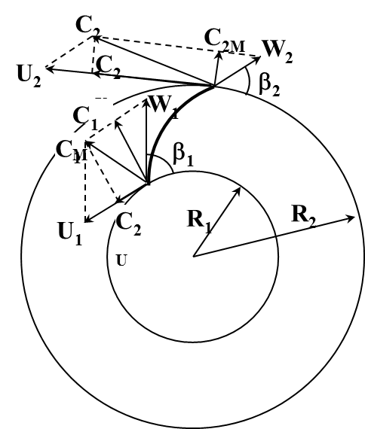
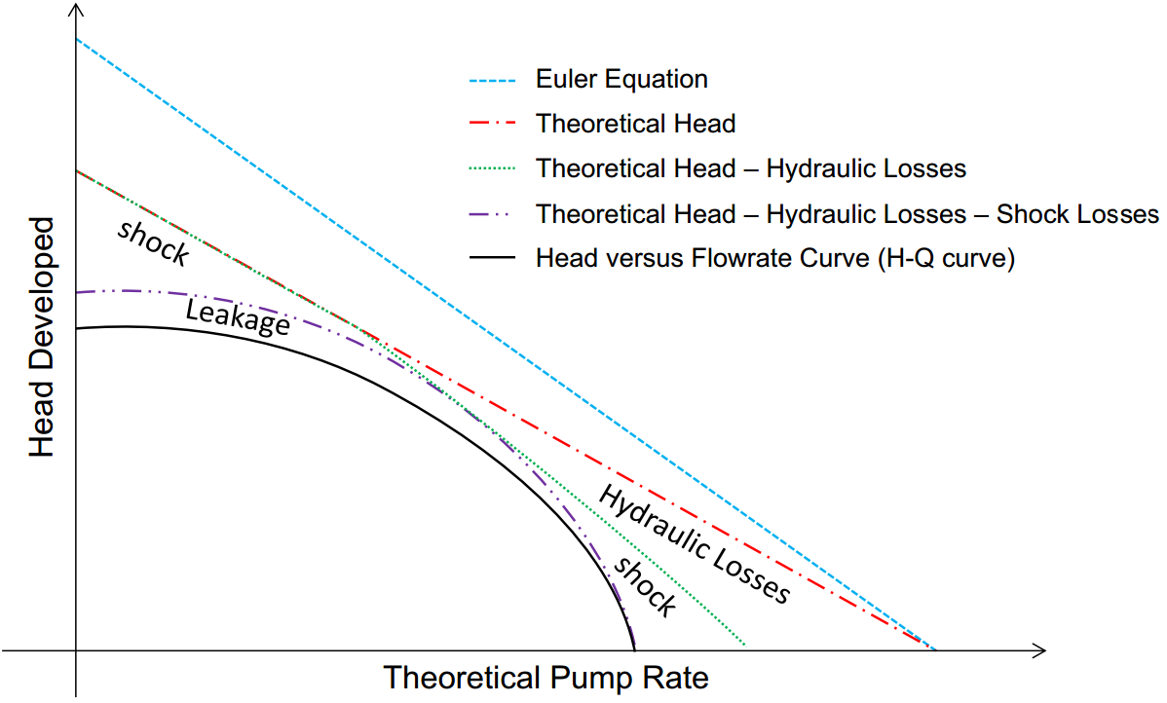
Mechanistic Model Overview
Euler head
No pre-rotation
Real head

Slide 11
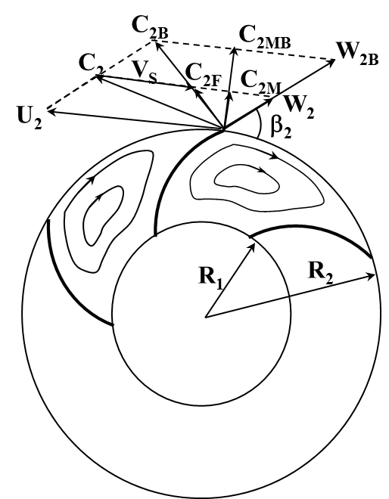
Mechanistic Model Overview…
Recirculation loss
Q < Q_{B}
Recirculation flow

Slide 12
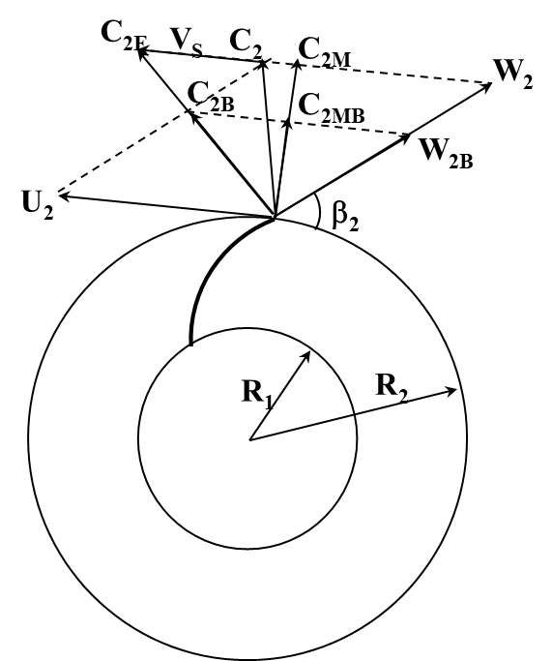
Mechanistic Model Overview…
Recirculation loss
Q > Q_{B}
Recirculation loss

Slide 13
Mechanistic Model Overview…
Friction loss
Turn loss
Leakage loss
f_{FI} and f_{FD} from Churchill’s correlation
f_{TI} and f_{TD} from experimental data
f_{LK} from Churchill’s correlation

Slide 14
Mechanistic Model Overview…
Based on force balance on single bubble in rotating impeller
Centrifugal buoyancy force
Drag force
Slippage velocity in radial direction
F_{D}
F_{C}
ω

Slide 15
Mechanistic Model Overview…
V_{SR} = V_{LR} – V_{GR}, where
Thus
Then

Slide 16
Closure Relationships
Emulsion rheology
Based on Brinkman (1952) correlation
At inversion point:

Slide 17
Closure Relationships…
Emulsion rheology
Water cut at inversion point
Apparent viscosity
Mixture viscosity

Slide 18
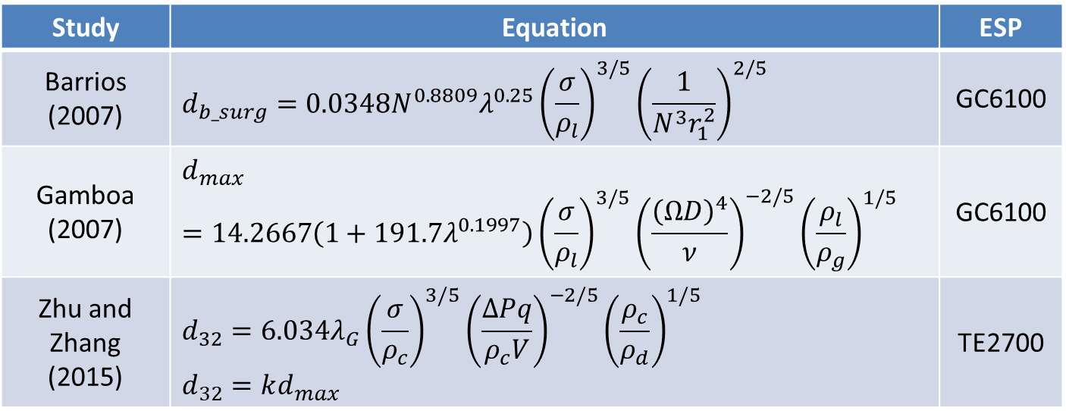
Closure Relationships…
In-situ bubble sizes
Study | Equation | ESP
Barrios (2007) | $$d_{b_surg}=0.0348N^{0.8809}λ^{0.25}{\left(\frac{σ}{ρ_{l}}\right)}^{3/5}{\left(\frac{1}{N^{3}r_{1}^{2}}\right)}^{2/5}$$ | GC6100
Gamboa (2007) | $$d_{max}=14.2667\left(1+191.7λ^{0.1997}\right){\left(\frac{σ}{ρ_{l}}\right)}^{3/5}{\left(\frac{{\left(ΩD\right)}^{4}}{ν}\right)}^{−2/5}{\left(\frac{ρ_{l}}{ρ_{g}}\right)}^{1/5}$$ | GC6100
Zhu and Zhang (2015) | $$d_{32}=6.034λ_{G}{\left(\frac{σ}{ρ_{c}}\right)}^{3/5}{\left(\frac{ΔPq}{ρ_{c}V}\right)}^{−2/5}{\left(\frac{ρ_{c}}{ρ_{d}}\right)}^{1/5}$$ $$d_{32}=kd_{max}$$ | TE2700

Slide 19
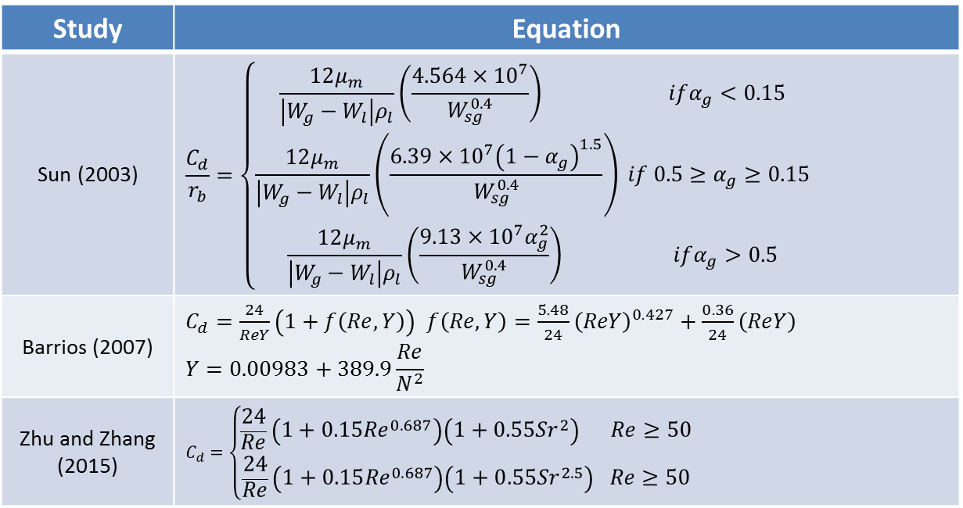
Closure Relationships…
Drag coefficient
Study | Equation
Sun (2003) | $$\frac{C_{d}}{r_{b}}=\left\{\begin{aligned}\frac{12μ_{m}}{\left|W_{g}−W_{l}\right|ρ_{l}}\left(\frac{4.564×{10}^{7}}{W_{sg}^{0.4}}\right) ifα_{g}<0.15 \\ \frac{12μ_{m}}{\left|W_{g}−W_{l}\right|ρ_{l}}\left(\frac{6.39×{10}^{7}{\left(1−α_{g}\right)}^{1.5}}{W_{sg}^{0.4}}\right) if 0.5≥α_{g}≥0.15 \\ \frac{12μ_{m}}{\left|W_{g}−W_{l}\right|ρ_{l}}\left(\frac{9.13×{10}^{7}α_{g}^{2}}{W_{sg}^{0.4}}\right) ifα_{g}>0.5\end{aligned}\right.$$
Barrios (2007) | $C_{d}=\frac{24}{ReY}\left(1+f\left(Re, Y\right)\right)$ $f\left(Re, Y\right)=\frac{5.48}{24}{\left(ReY\right)}^{0.427}+\frac{0.36}{24}\left(ReY\right)$ $$Y=0.00983+389.9\frac{Re}{N^{2}}$$
Zhu and Zhang (2015) | $$C_{d}=\left\{\begin{aligned}\frac{24}{Re}\left(1+0.15{Re}^{0.687}\right)\left(1+0.55{Sr}^{2}\right) Re≥50 \\ \frac{24}{Re}\left(1+0.15{Re}^{0.687}\right)\left(1+0.55{Sr}^{2.5}\right) Re≥50\end{aligned}\right.$$

Slide 20
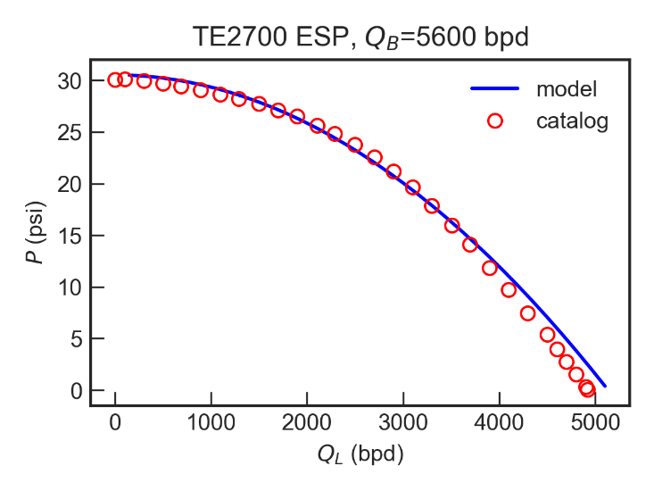
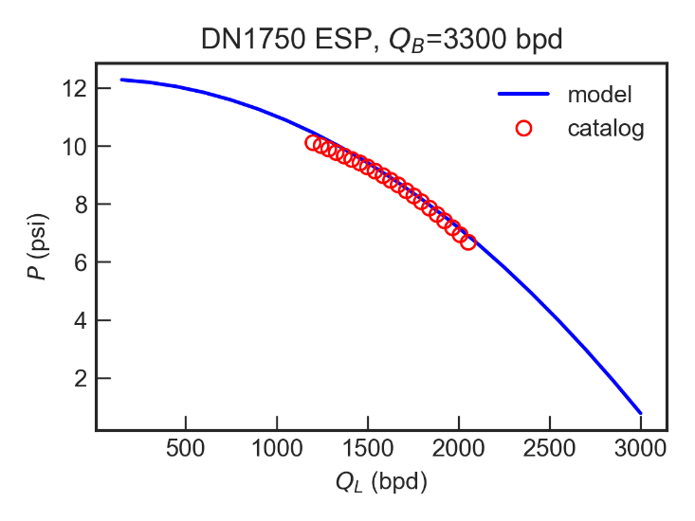
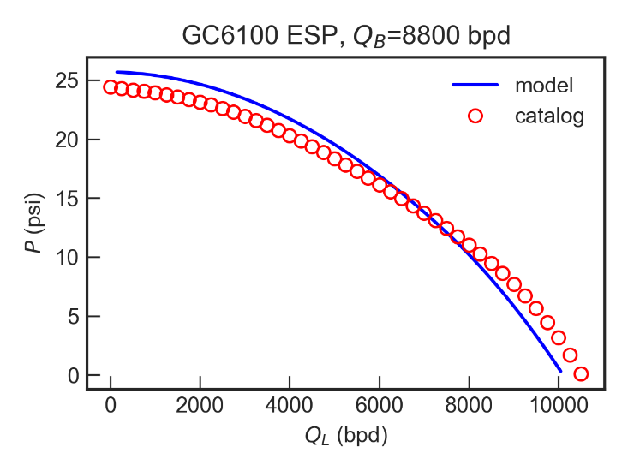
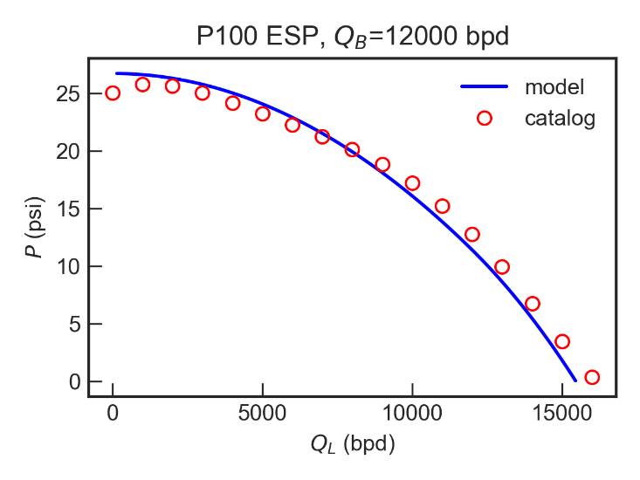
Single-phase Flow
Water performance

Slide 21
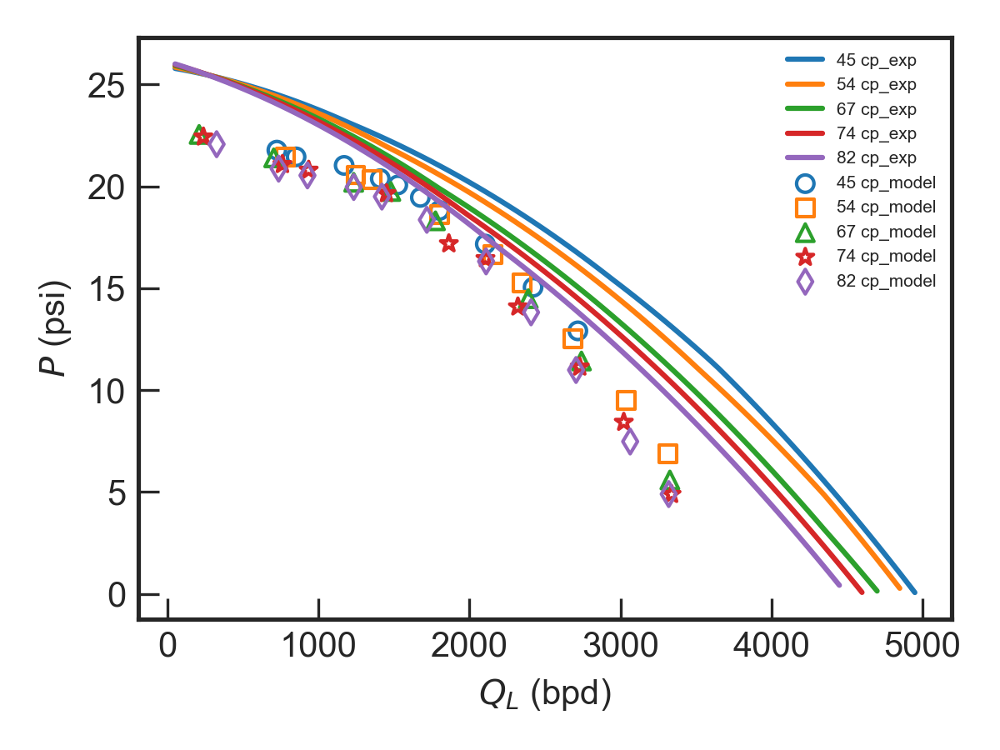
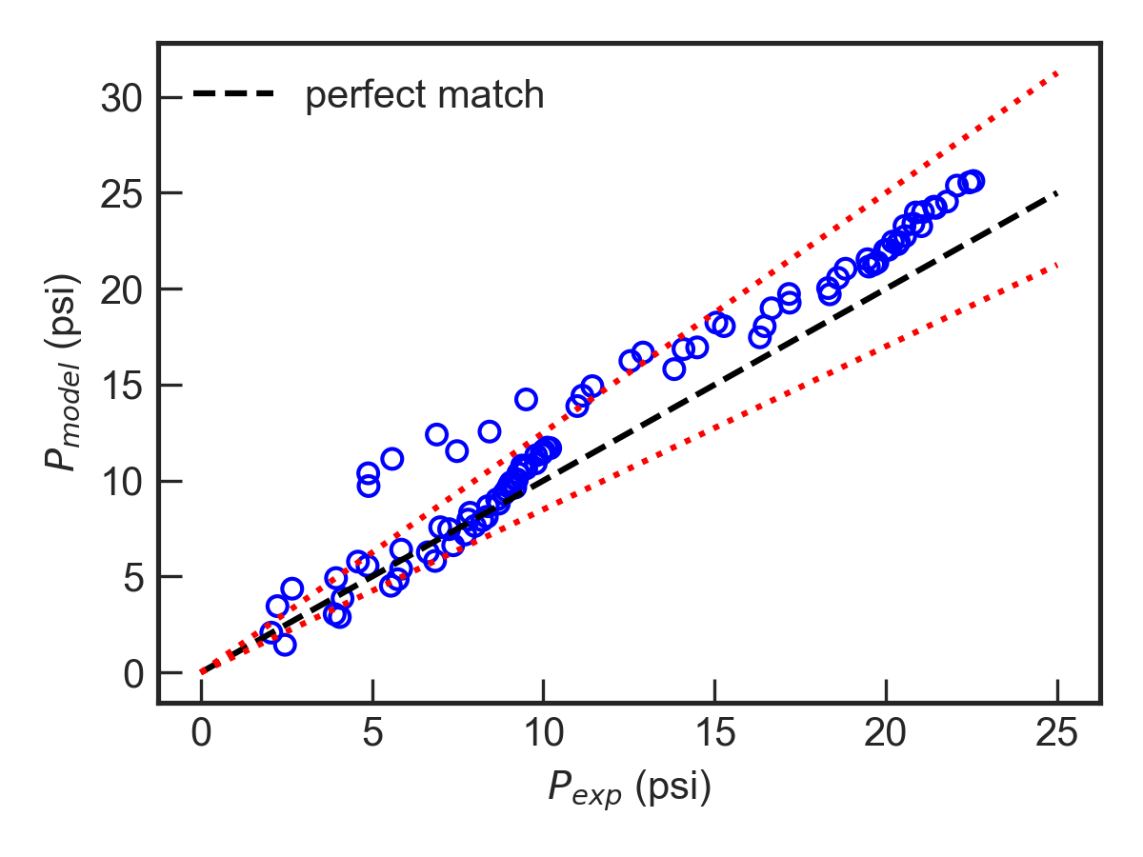
Single-phase Flow
TE-2700 ESP
Zhang (2017), 94 data points
N = 3500 rpm
N = 2400, 3500 rpm
+25%
-15%

Slide 22
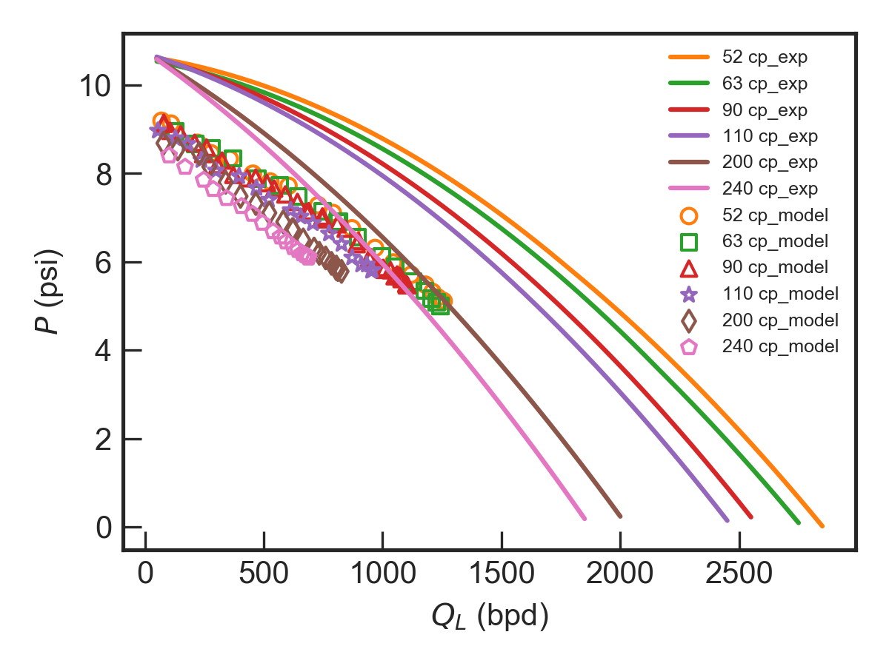
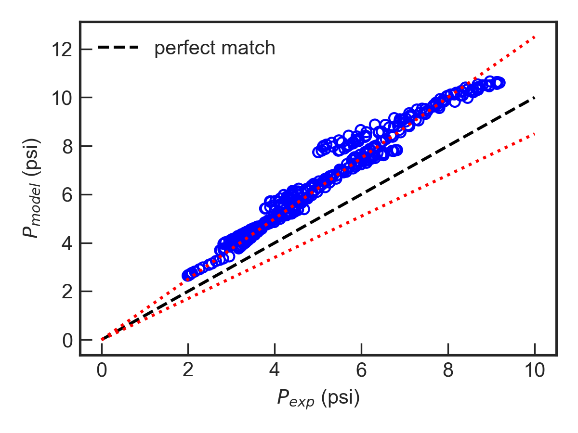
Single-phase Flow…
DN-1750 ESP
Banjar (2018), 424 data points
N = 3500 rpm
N = 2000, 2500, 3000, 3500 rpm
+25%
-15%

Slide 23
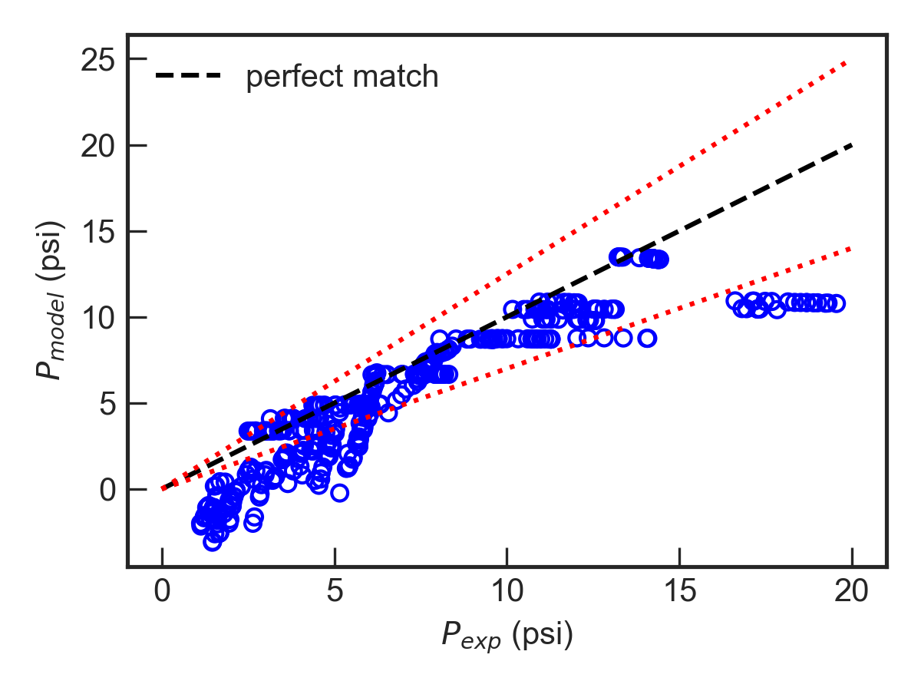
Single-phase Flow…
DN-1750 ESP
Solano (2009), 420 data points randomly selected from 168,883 points database
+25%
-30%

Slide 24
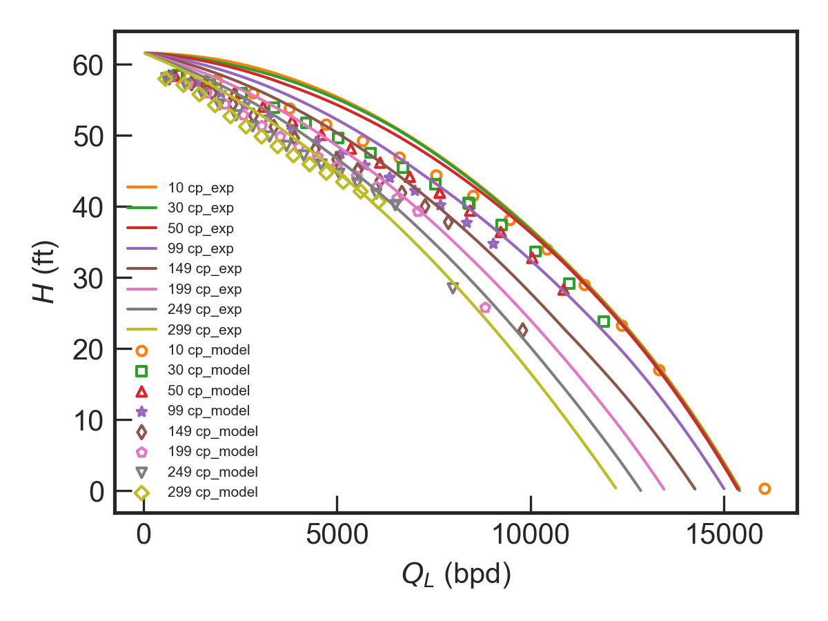
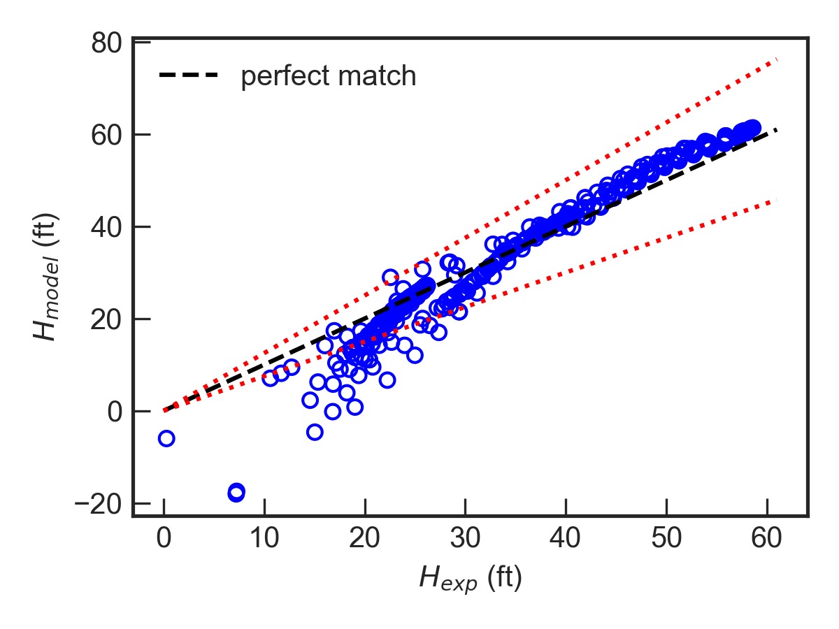
Single-phase Flow…
P100 ESP
BHI, 373 data points
N = 3600 rpm
N = 3600, 2400 rpm
+25%
-25%

Slide 25
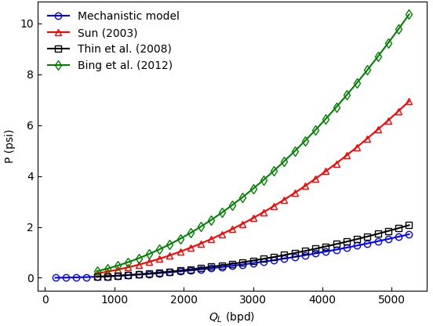
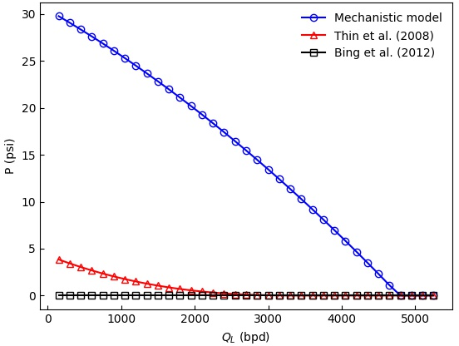
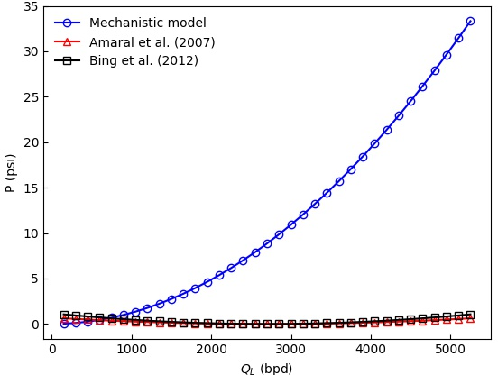
Mechanistic Model Modification
Pressure loss comparison
From experimental data
Friction loss is underestimated for large Q_{L}
Recirculation loss is overestimated for small Q_{L}
Shock loss is overestimated for high Q_{L}
Friction
Recirculation
Shock

Slide 26
Mechanistic Model Modification…
Mechanistic model predictions of ESP performance for viscous fluid flow need to be improved
Special considerations on low flow rates, high viscosities, low rotational speeds
Improvement can be made with
Friction factor correlation
Best match flow rates at off-design conditions
Theoretical head correction

Slide 27
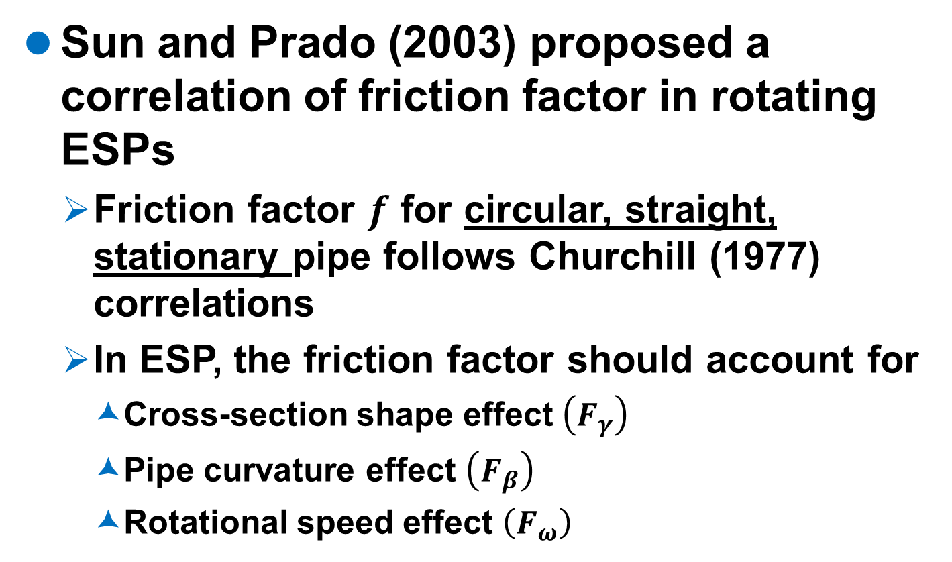
Mechanistic Model Modification…
Sun and Prado (2003) proposed a correlation of friction factor in rotating ESPs
Friction factor $f$ for circular, straight, stationary pipe follows Churchill (1977) correlations
In ESP, the friction factor should account for
Cross-section shape effect $\left(F_{γ}\right)$
Pipe curvature effect $\left(F_{β}\right)$
Rotational speed effect $\left(F_{ω}\right)$

Slide 28

Mechanistic Model Modification…
Reynolds number is given as
Churchill (1977) friction factor $f$
Cross section shape effect $\left(F_{γ}\right)$

Slide 29

Mechanistic Model Modification…
Pipe curvature effect $\left(F_{β}\right)$
Critical Reynolds number
Laminar effect (Re < N_{Re})

Slide 30

Mechanistic Model Modification…
Pipe curvature effect $\left(F_{β}\right)$
Turbulent effect (Re > N_{Re})

Slide 31

Mechanistic Model Modification…
Rotational speed effect $\left(F_{ω}\right)$
Critical Reynolds number
Laminar effect (Re < N_{Re})

Slide 32

Mechanistic Model Modification…
Rotational speed effect $\left(F_{ω}\right)$
Turbulent effect (Re > N_{Re})
Thus, friction factor is calculated as: $f_{γβω}=F_{γ}F_{β}F_{ω}f$
Friction loss is given by
$h_{friction}=\frac{f_{γβω}Q^{2}}{8gD_{H}π^{2}b_{m}^{2}\sin^{3}β_{m}}\frac{r_{2}−r_{1}}{r_{1}r_{2}}$

Slide 33
Mechanistic Model Modification…
Best match flow rate (Q_{B}) should consider
Liquid viscosity and pump rotational speed
Shearing factor
n – constant depending on experimental data

Slide 34
Mechanistic Model Modification…
Theoretical pump head correction
Euler head without pre-rotation
Wiesner (1967)
Zhang (2017)

Slide 35
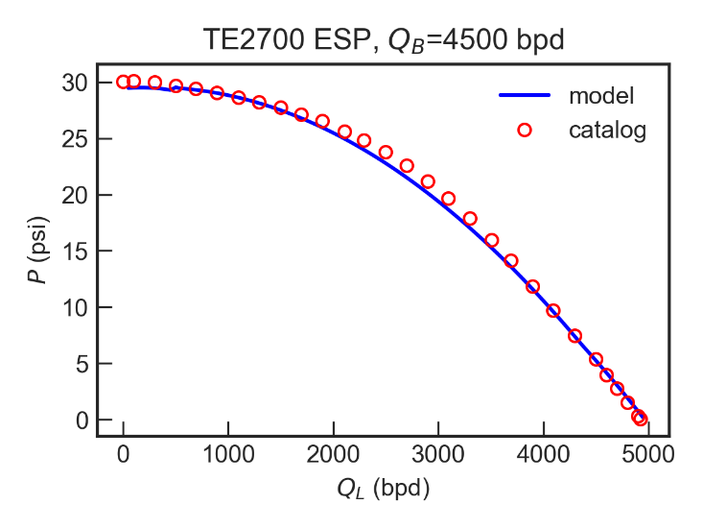
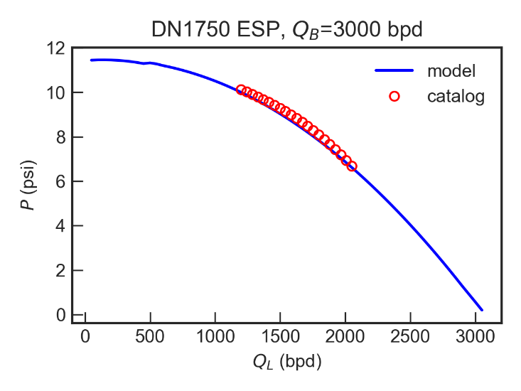
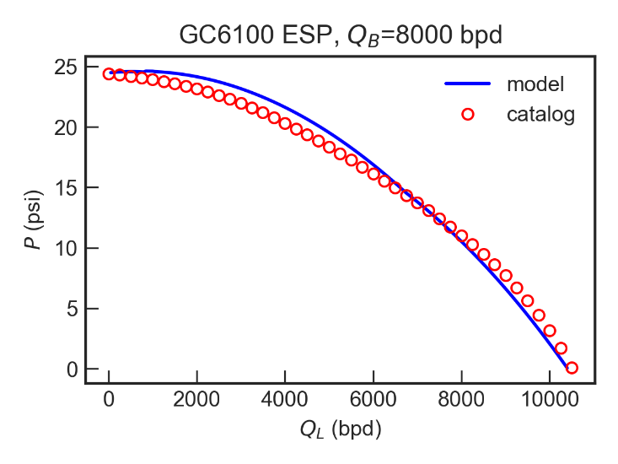
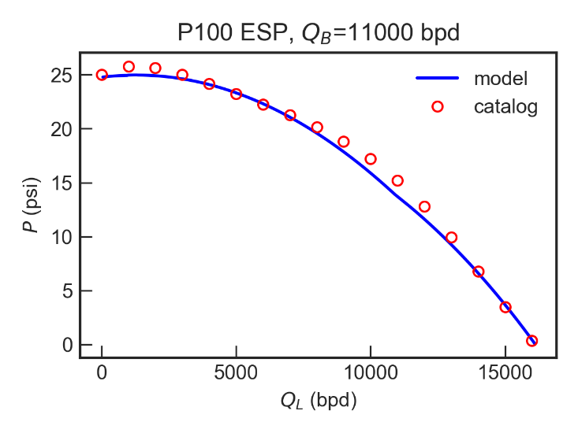
Single-phase Flow…
Water performance

Slide 36
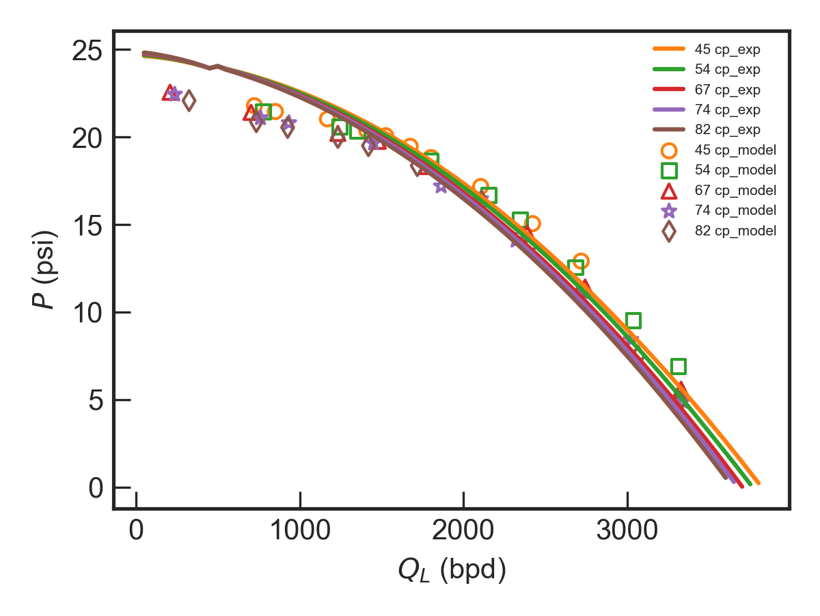
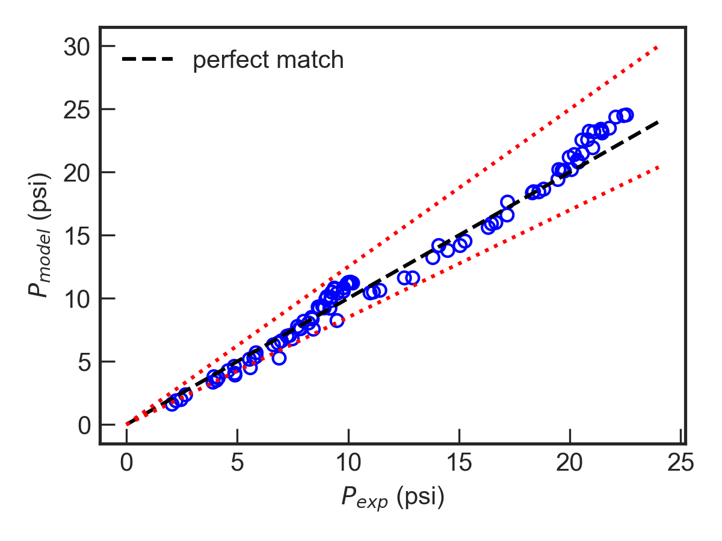
Single-phase Flow
TE-2700 ESP
Zhang (2017), 94 data points
N = 3500 rpm
N = 2400, 3500 rpm
+25%
-15%

Slide 37
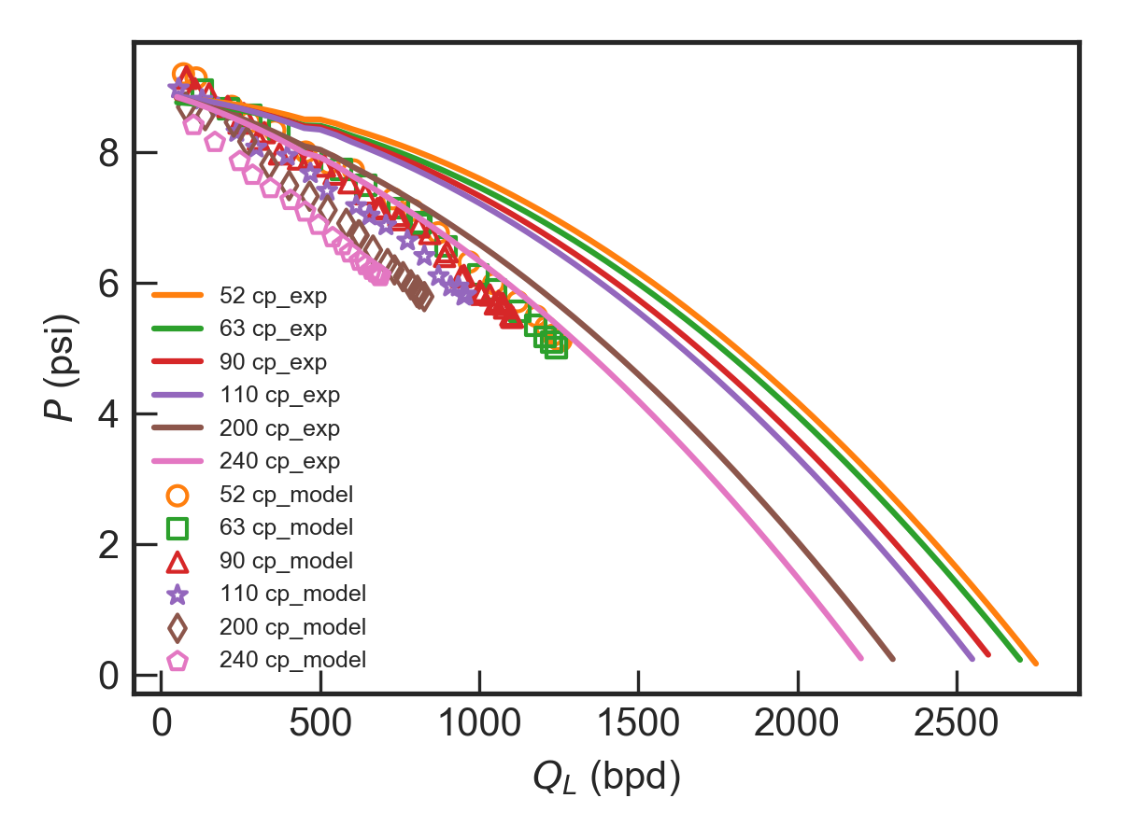
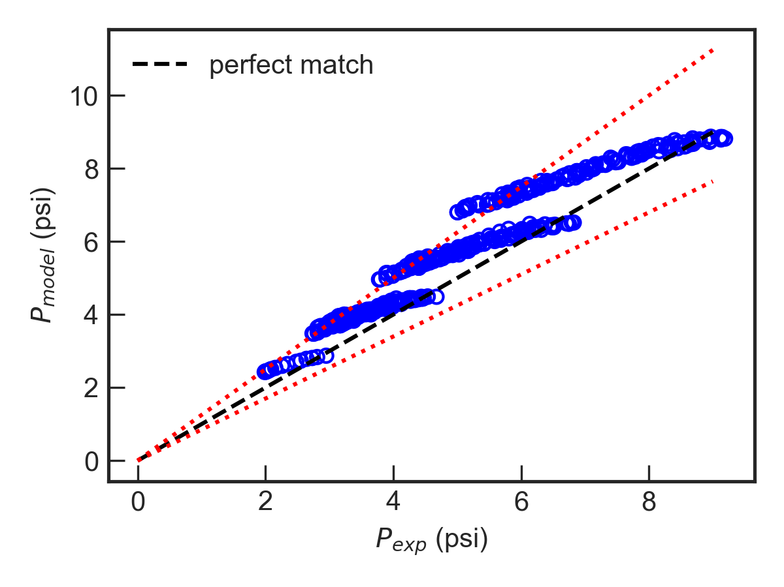
Single-phase Flow…
DN-1750 ESP
Banjar (2018), 424 data points
N = 3500 rpm
N = 2000, 2500, 3000, 3500 rpm
+25%
-15%

Slide 38
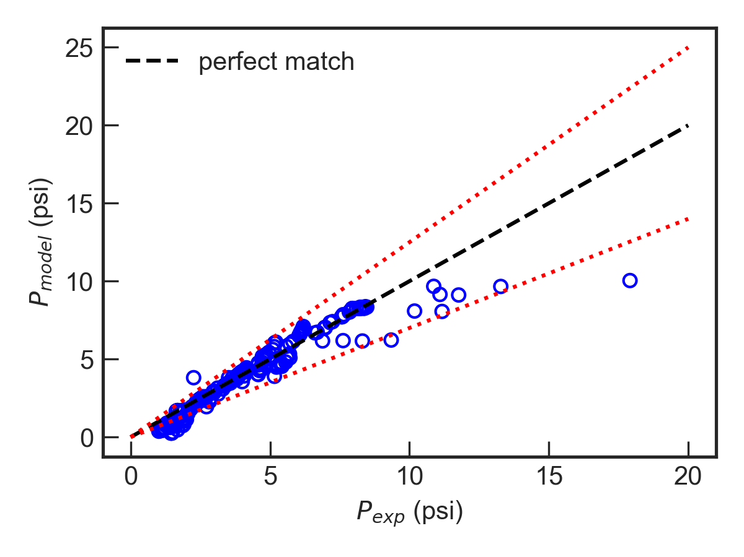
Single-phase Flow…
DN-1750 ESP
Solano (2009)
+25%
-30%

Slide 39
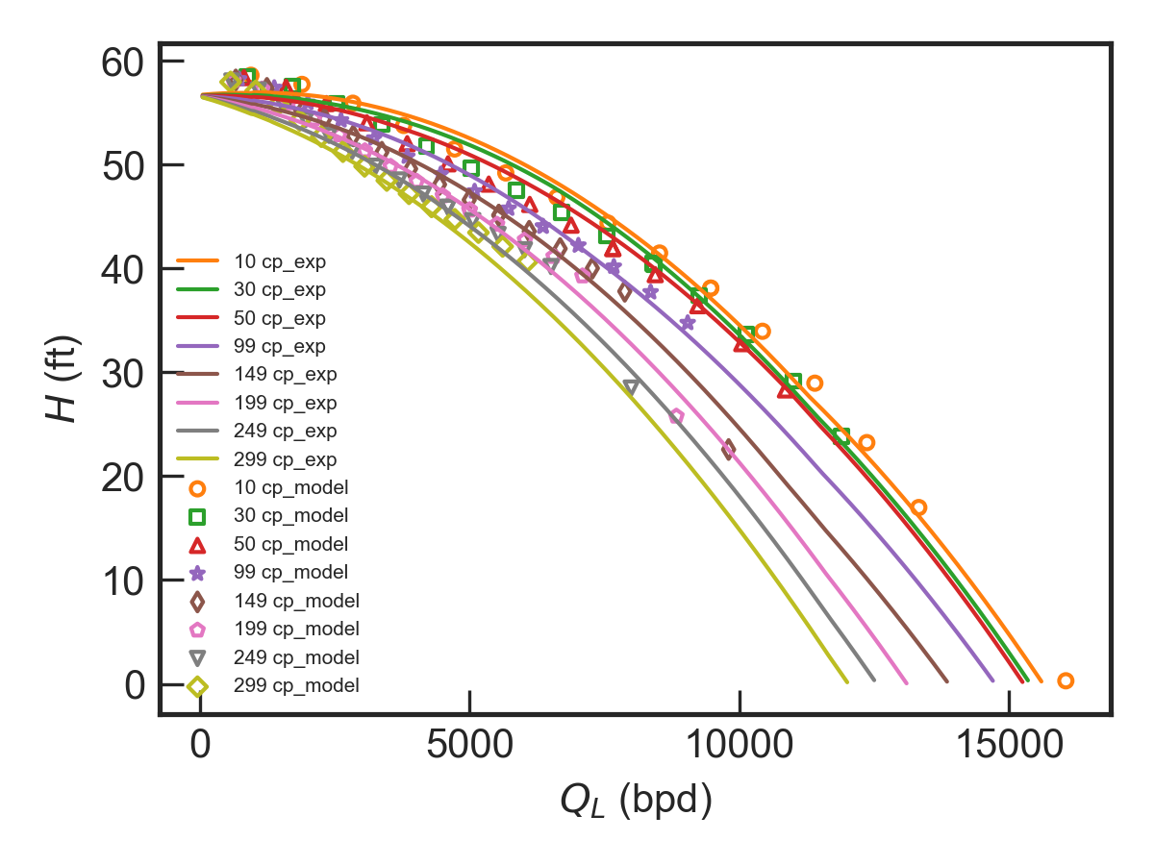
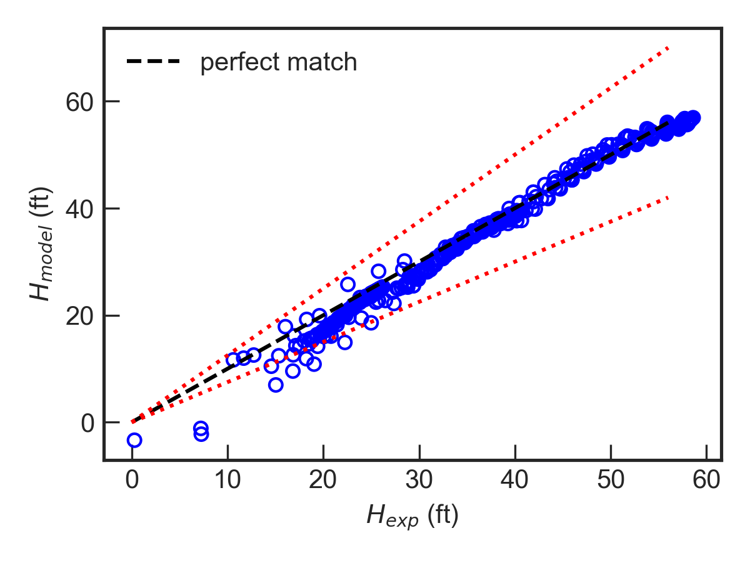
Single-phase Flow…
P100 ESP
BHI, 373 data points
N = 3600 rpm
N = 3600, 2400 rpm
+25%
-15%

Slide 40
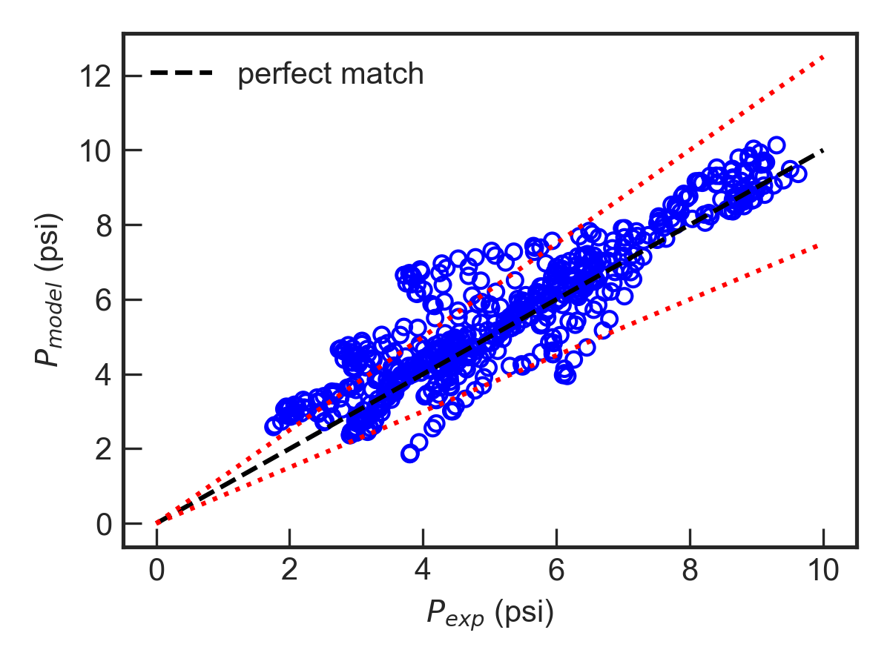
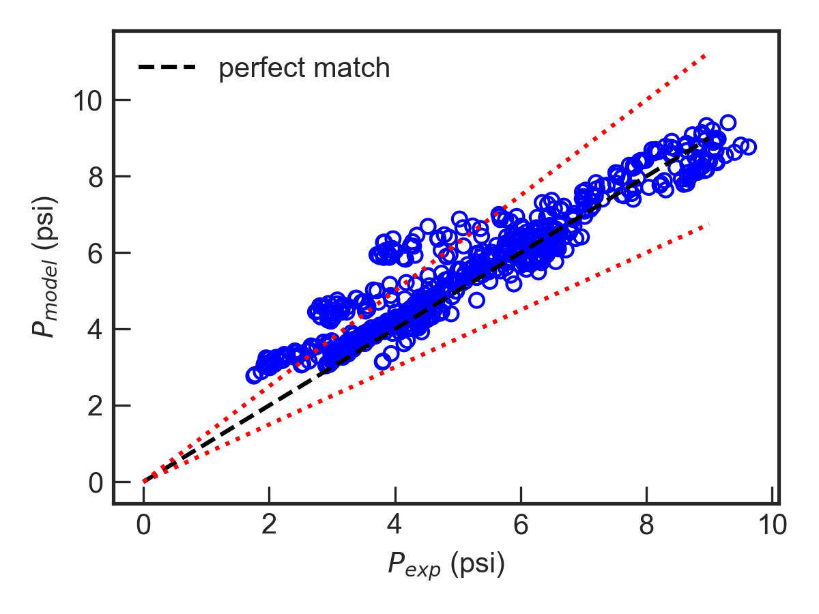
Emulsion Flow
DN-1750 ESP
Banjar (2018), 603 data points
Previous model
New model
+25%
+25%
-25%
-25%

Slide 41
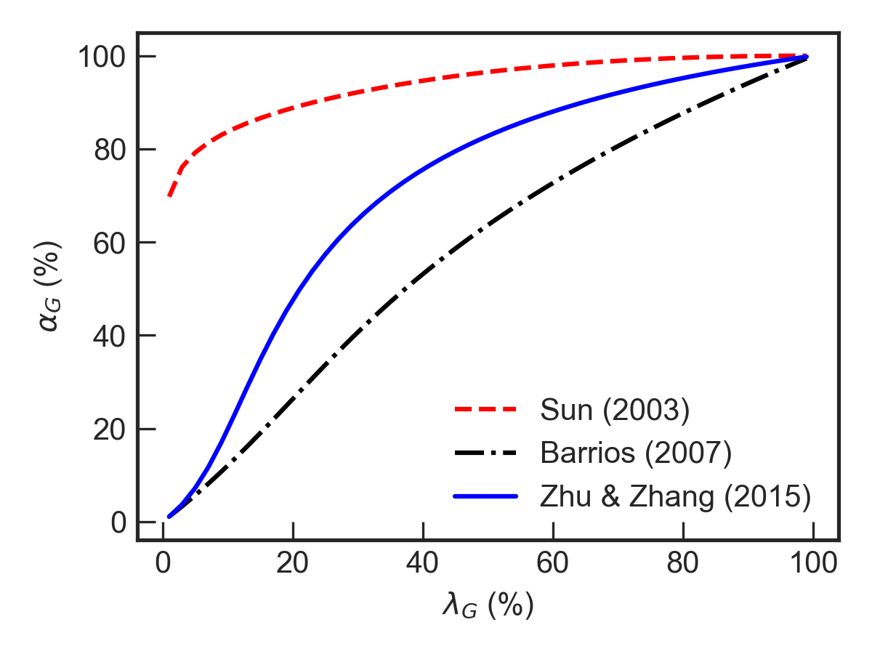
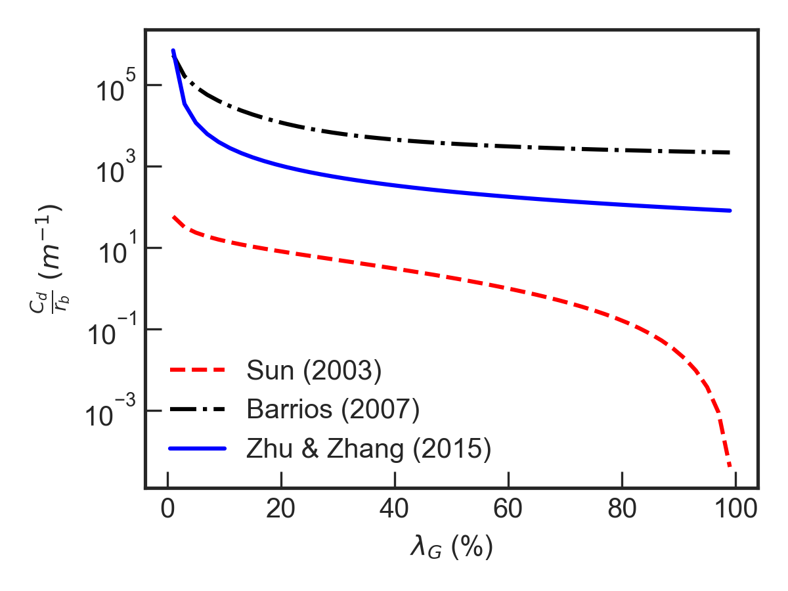
Gas-liquid Two-phase Flow
Comparison of drag force coefficient
TE-2700, N = 3500 rpm, Q_{L} = 2700 bpd, ρ_{G} = 11.2 kg/m³

Slide 42
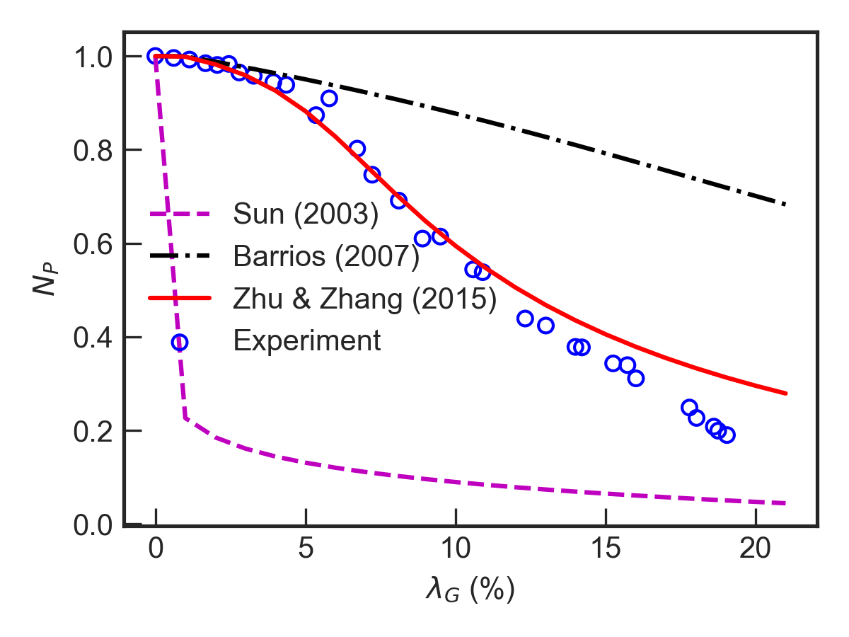
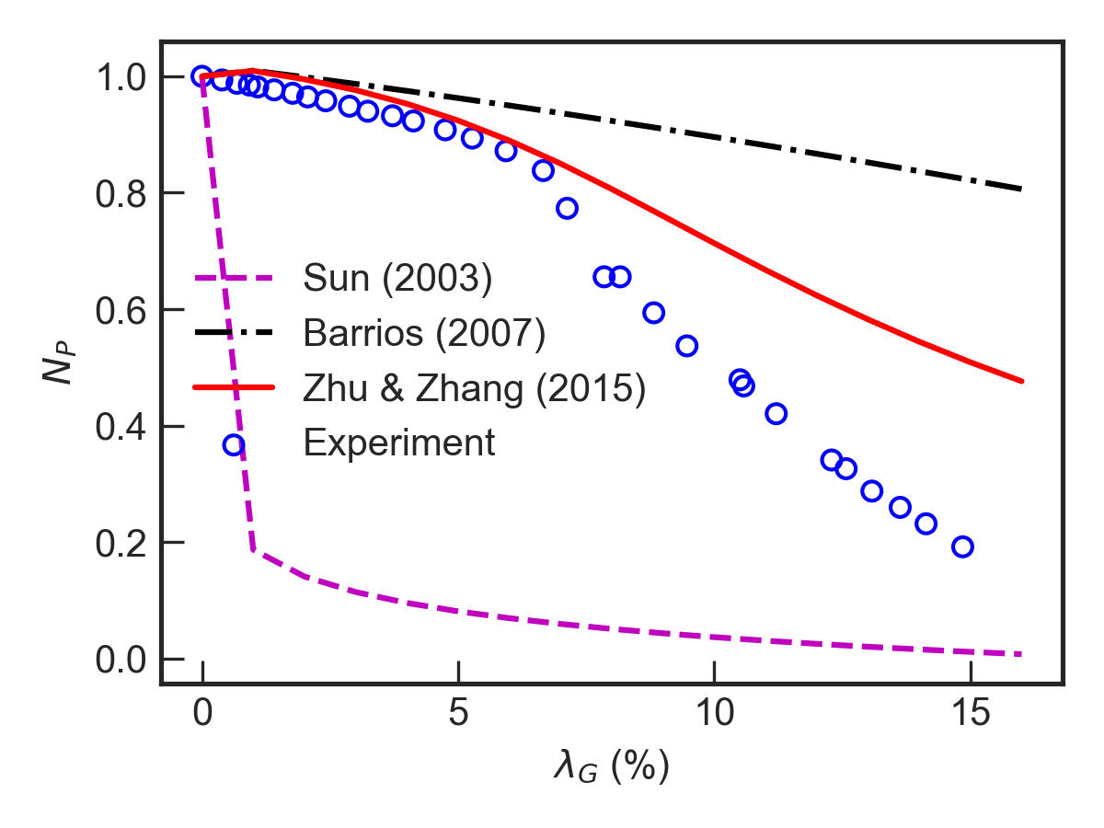
Gas-liquid Two-phase Flow…
Comparison of model prediction
Zhu (2017) experimental data, TE-2700, N = 3500 rpm, P_{sep} = 150 psig
Q_{L} = 0.75Q_{BEP}
Q_{L} = Q_{BEP}

Slide 43
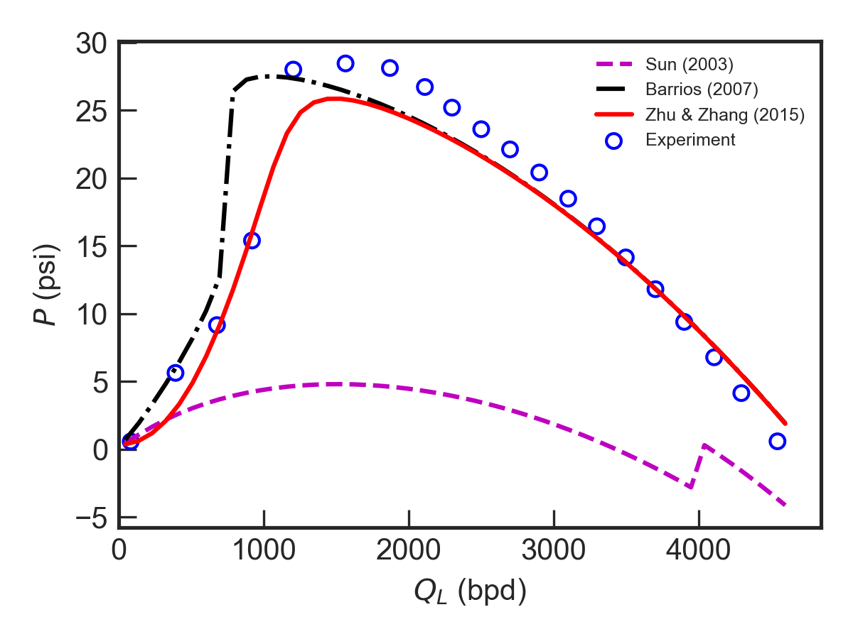
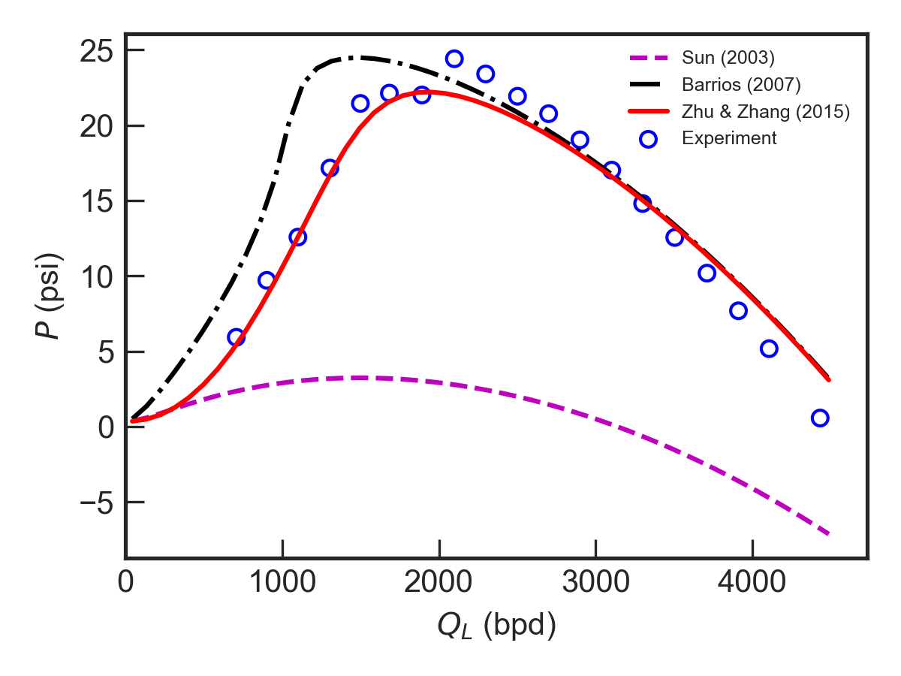
Gas-liquid Two-phase Flow…
Comparison of model prediction
Zhu (2017) experimental data, TE2700, N = 3500 rpm, P_{sep} = 150 psig
Q_{gd} = 0.01
Q_{gd} = 0.03

Slide 44
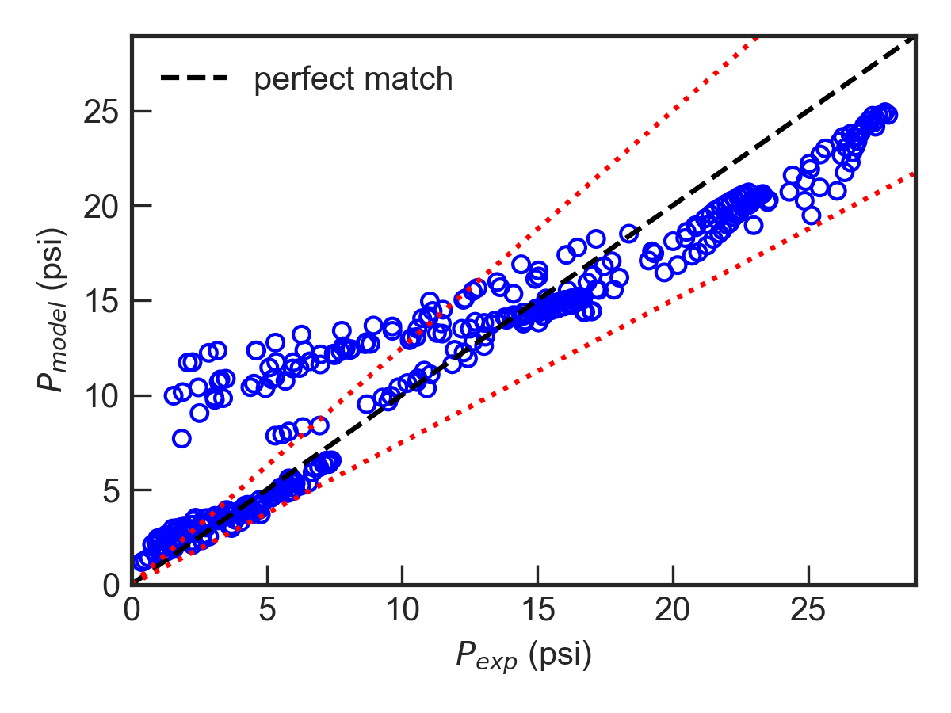
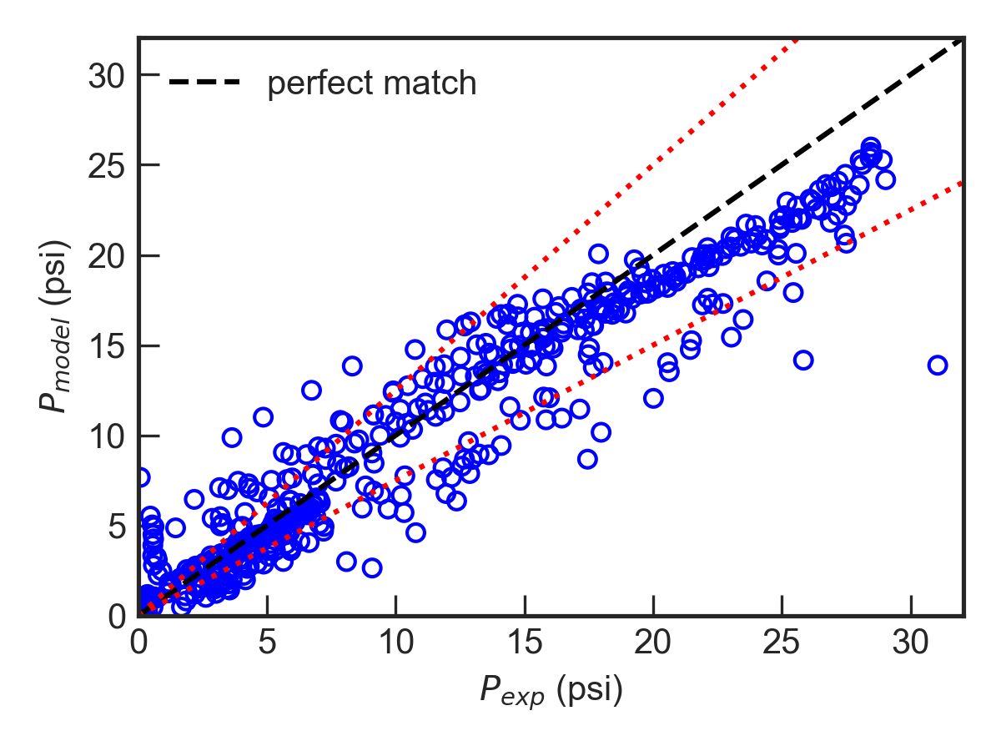
Gas-liquid Two-phase Flow…
Comparison with Zhu (2017) data
P_{sep}: 50, 100, 150 psig
N: 1800, 3500 rpm at stage 3
Surging test
Mapping test
+25%
+25%
-25%
-25%

Slide 45




Gas-liquid Two-phase Flow…
Comparison with Gamboa (2007) data
N = 3500 rpm, P_{in} = 150 psig, Q_{gd} = 0.1, 0.2, 0.3, 0.4
Qgd = 0.01
Qgd = 0.02
Qgd = 0.03
Qgd = 0.04

Slide 46
Conclusions and Discussions
Mechanistic model is verified with a large database with more than ~190K data points
For single-phase and emulsion flow, the mechanistic model predicts ESP boosting pressure with good agreement against experimental measurements
Prediction error for ESP single-phase or emulsion flow boosting pressure is around 25%
The mechanistic model predictions of ESP boosting pressure under gas-liquid two-phase flow needs to be improved with better closure relationships

Slide 47
Future Work
Improve mechanistic model for ESP boosting pressure under single-phase or emulsion flow and validate with more experimental data
Review closure relationships for two-phase pipe flow, develop more suitable correlation for drag coefficient in rotating ESPs
Verify mechanistic model with improved closure relationships against experimental data

